Slide 1
Semester Project: Web Scraping www.nilcollegeathletes.com
Scott Ricketts
ECON 8320: Tools for Data Analysis
Spring 2023

Slide 2

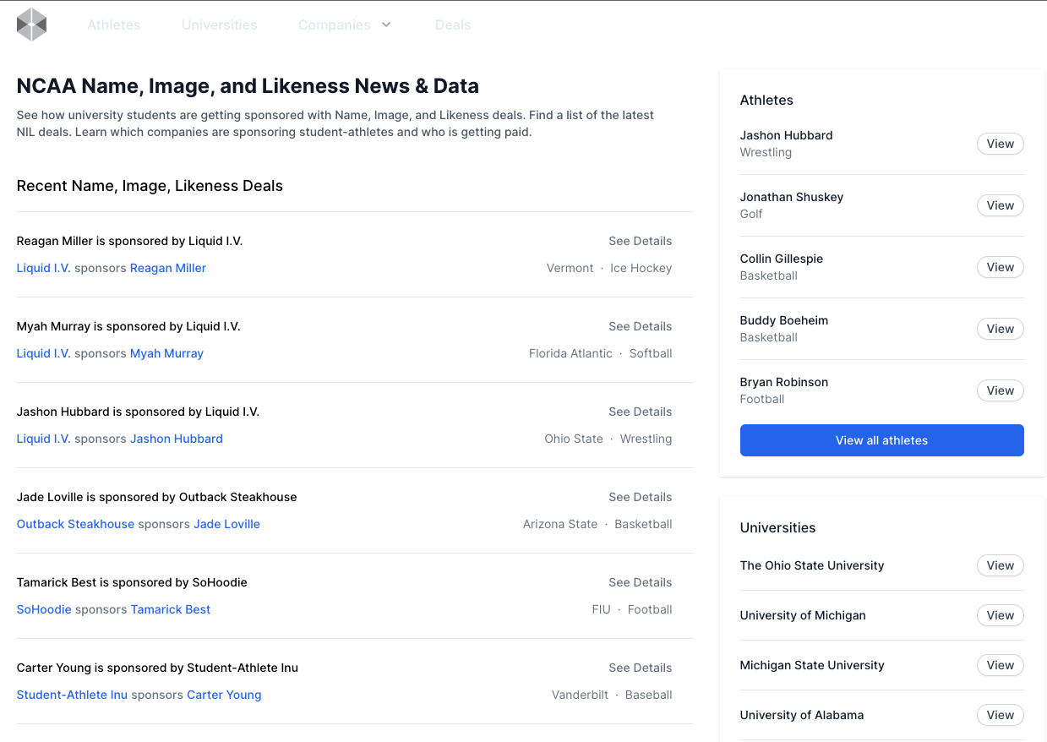
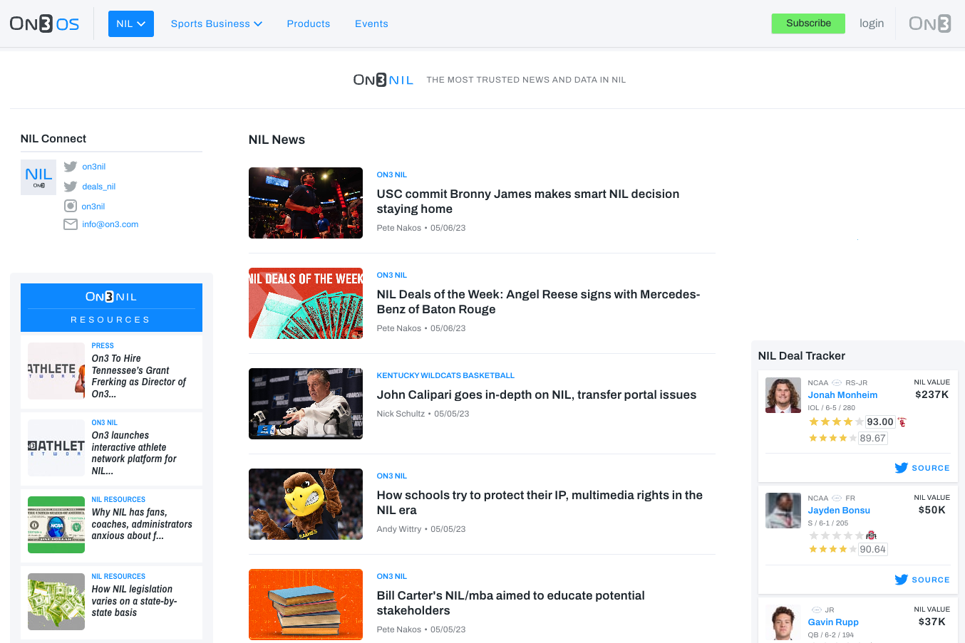
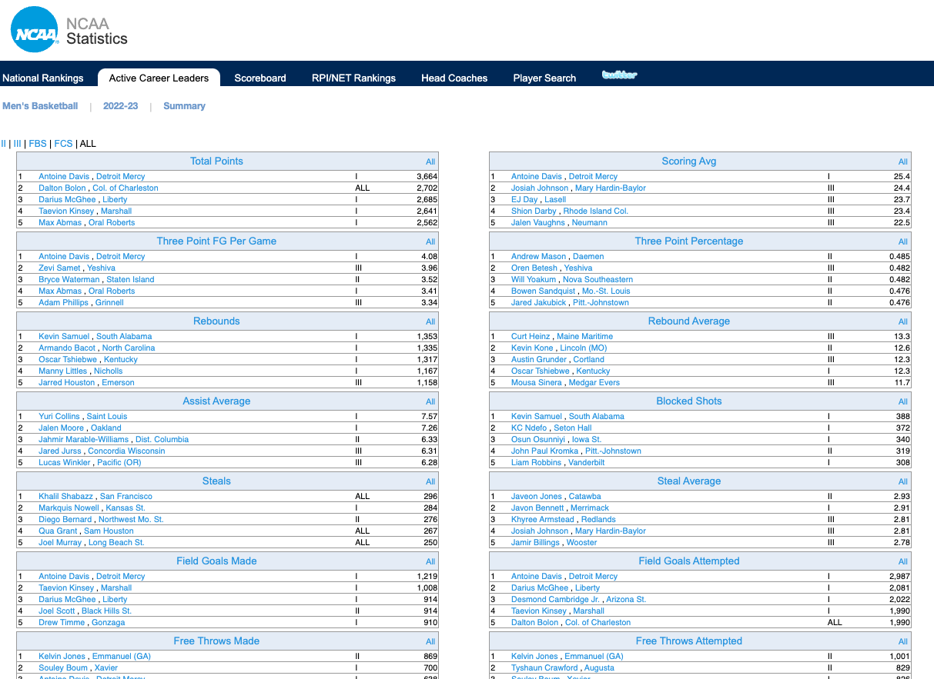
The Proposal

Slide 3



The Proposal
The Reality
Just this one + some px charts

Slide 4
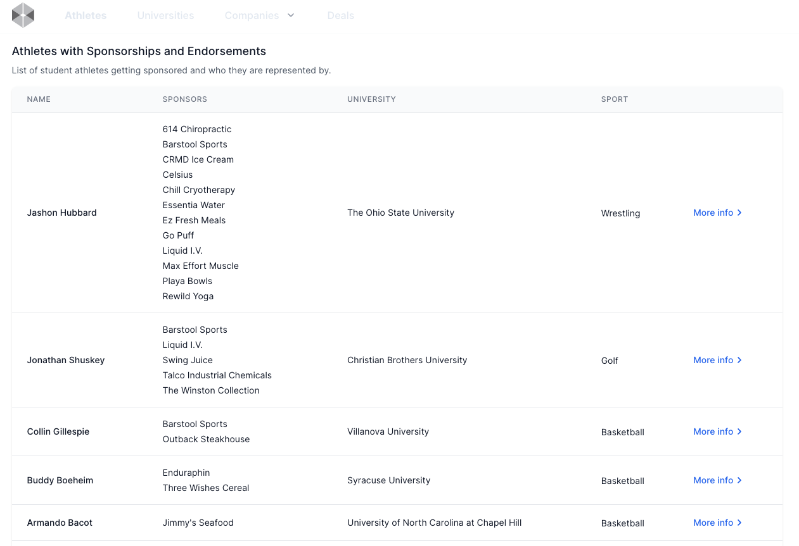
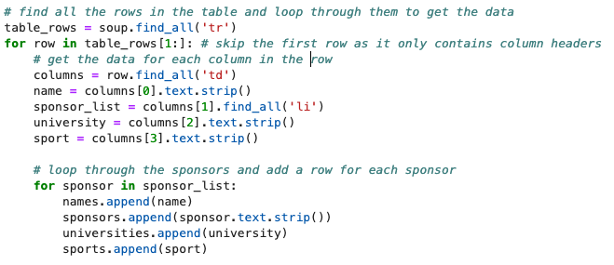
NIL Main Athlete Page
First Challenge:
Collecting each sponsor for athlete who had more than one

Slide 5
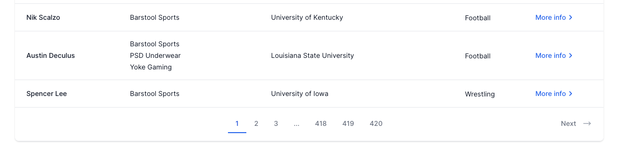
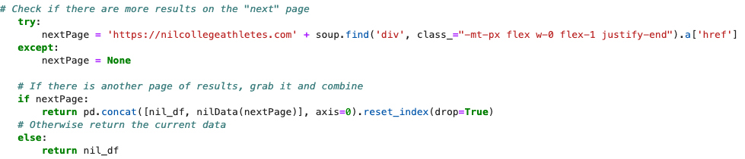
NIL Main Athlete Page (cont.)
Second Challenge:
Looking for “Next” and concatenating the data frames into one

Slide 6
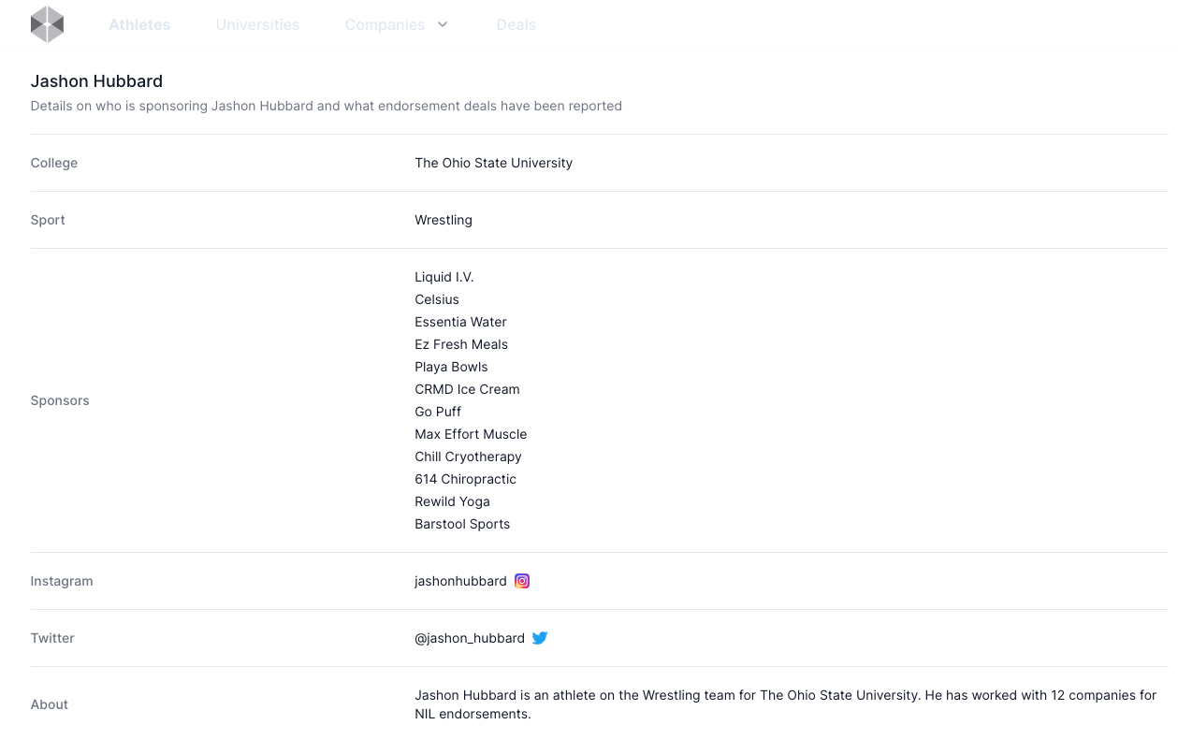
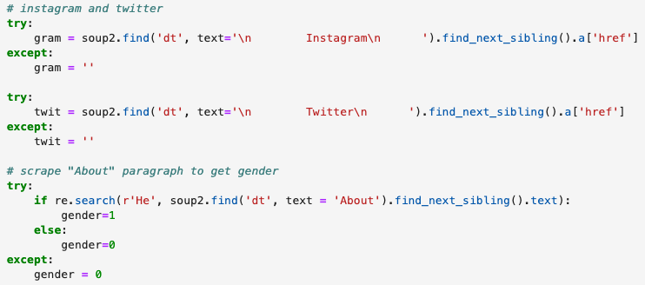
NIL More Info Page
Third Challenge:
Navigating to “More Info” page
Scraping social media and gender, creating data frame

Slide 7
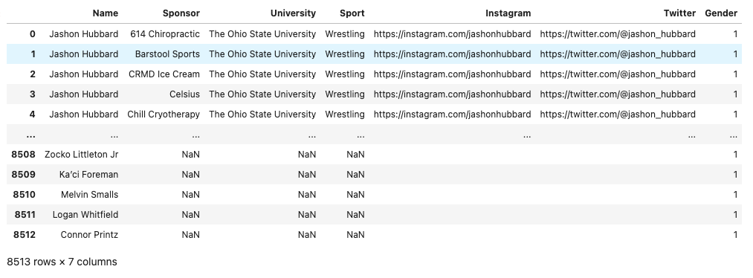
Clean NIL Data
Fourth Challenge:
Merging both data frames into on clean data set

Slide 8
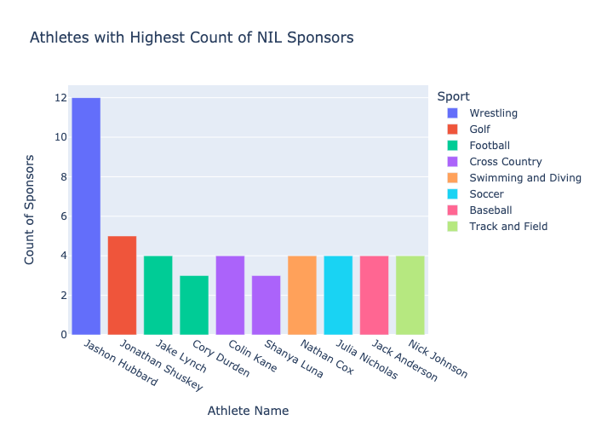
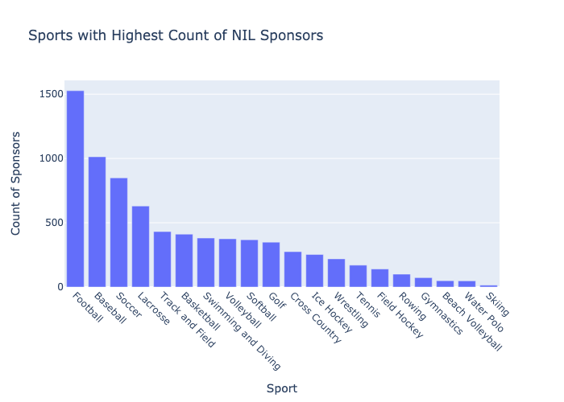
Analysis & Visualizations

Slide 9
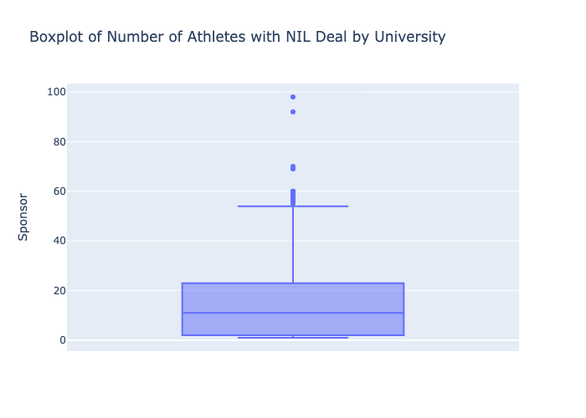
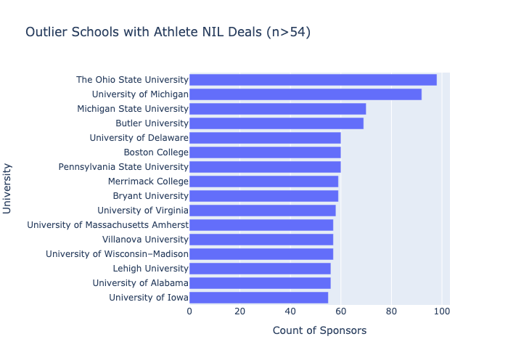
Analysis & Visualizations

Slide 10
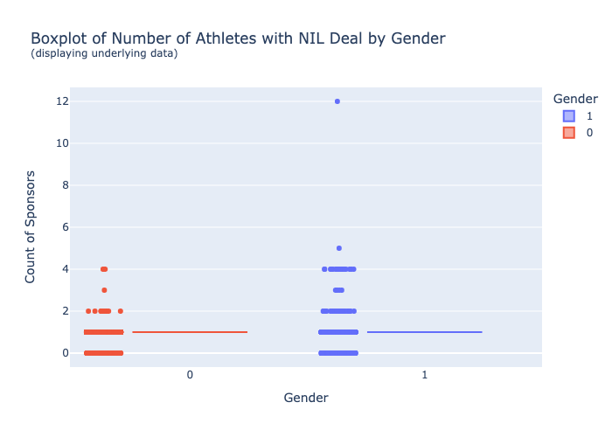
Analysis & Visualizations

Slide 11
The End
Any Questions?

